Slide 1
Ethics in Information Technology, Second Edition
Chapter 4
Privacy

Slide 2
Objectives
What is the right of privacy, and what is the basis for protecting personal privacy under the law?
What are some of the laws that authorize electronic surveillance by the government, and what are the associated ethical issues?
What are the two fundamental forms of data encryption, and how does each work?
Ethics in Information Technology, Second Edition

Slide 3
Objectives (continued)
What is identity theft, and what techniques do identity thieves use?
What are the various strategies for consumer profiling and the associated ethical issues?
What must organizations do to treat consumer data responsibly?
Ethics in Information Technology, Second Edition

Slide 4
Objectives (continued)
Why and how are employers increasingly using workplace monitoring?
What is spamming, and what ethical issues are associated with its use?
What are the capabilities of advanced surveillance technologies, and what ethical issues do they raise?
Ethics in Information Technology, Second Edition

Slide 5
What does privacy mean to you?

Slide 6

What is privacy?
“Being alone.”
Al-Bara Al-Ohli (age 4)
Ethics in Information Technology, Second Edition

Slide 7
Westin “Privacy and Freedom” 1967
“Privacy is the claim of individuals, groups or institutions to determine for themselves when, how, and to what extent information about them is communicated to others”
Privacy is not an absolute
Ethics in Information Technology, Second Edition
Notes:
Absolute - not qualified or diminished in any way; total / a value or principle which is regarded as universally valid or which may be viewed without relation to other things.

Slide 8
Privacy as process
“Each individual is continually engaged in a personal adjustment process in which he balances the desire for privacy with the desire for disclosure and communication….”
- Alan Westin, 1967
Ethics in Information Technology, Second Edition
Notes:
Westin’s definition envisions an individual actively involved in a decision making process.
It assumes a certain level of individual awareness of the consequences of both disclosing and not disclosing personal information, and the ability to effectively control whether information is disclosed.
Envisions - imagine as a future possibility; visualize

Slide 9
Westin’s four states of privacy
Solitude
  individual separated from the group and freed from the observation of other persons
Intimacy
  individual is part of a small unit
Anonymity
  individual in public but still seeks and finds freedom from identification and surveillance
Reserve
  the creation of a psychological barrier against unwanted intrusion - holding back communication
Ethics in Information Technology, Second Edition
Notes:
Solitude – the state or situation of being alone
Intimacy - close familiarity or friendship
Anonymity – the condition of being anonymous
Anonymous - (of a person) not identified by name; of unknown name / having no outstanding, individual, or unusual features; unremarkable or impersonal
Surveillance - close observation, especially of a suspected spy or criminal
Intrusion - the action of intruding / put oneself deliberately into a place or situation where one is unwelcome or uninvited

Slide 10
Privacy Protection and the Law
Systems collect and store key data from every interaction with customers
Many object to data collection policies of government and business
Privacy is a
  Key concern of Internet users
  Top reason why nonusers still avoid the Internet
Reasonable limits must be set
Historical perspective on the right to privacy
  Fourth Amendment - reasonable expectation of privacy
Ethics in Information Technology, Second Edition
Notes:
Amendment - a minor change or addition designed to improve a text, piece of legislation, etc

Slide 11
The Right of Privacy
Definition
  “The right to be left alone—the most comprehensive of rights, and the right most valued by a free people”
  “The right of individuals to control the collection and use of information about themselves”
Ethics in Information Technology, Second Edition
Notes:
Comprehensive - including or dealing with all or nearly all elements or aspects of something

Slide 12
The Right of Privacy (continued)
Legal aspects
  Protection from unreasonable intrusion upon one’s isolation
  Protection from appropriation of one’s name or likeness
  Protection from unreasonable publicity given to one’s private life
  Protection from publicity that unreasonably places one in a false light before the public
Ethics in Information Technology, Second Edition
Notes:
Isolation - the process or fact of isolating or being isolated
Isolating - (of a language) tending to have each element as an independent word without inflections.
Appropriate - take (something) for one's own use, typically without the owner's permission

Slide 13
Recent History of Privacy Protection
Legislative acts passed over the past 40 years
  Most address invasion of privacy by the government
    Not corporations
  No single, overarching national data privacy policy
    Communications Act of 1934
    Freedom of Information Act (FOIA)
    Fair Credit Reporting Act of 1970
    Privacy Act of 1974
    Children’s Online Protection Act (COPA)
    European Community Directive 95/46/EC of 1998
    Gramm-Leach-Bliley Act
Ethics in Information Technology, Second Edition
Notes:
Legislative - having the power to make laws
Invasion - an instance of invading a country or region with an armed force
Invade - (of an armed force) enter (a country or region) so as to subjugate or occupy it
Overarching - comprehensive or all-embracing

Slide 14
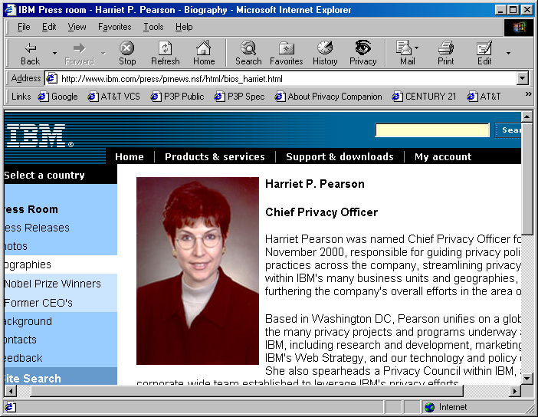
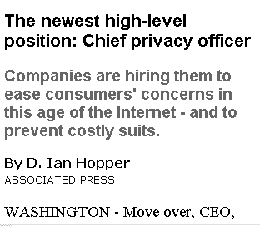
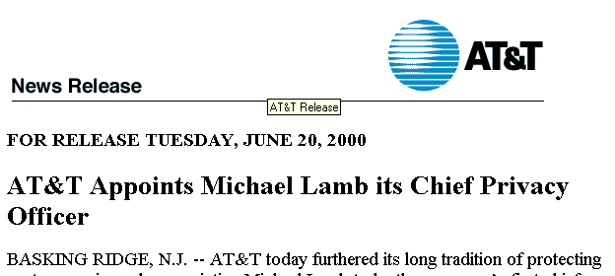
Ethics in Information Technology, Second Edition

Slide 15
Chief privacy officers
Companies are increasingly appointing CPOs to have a central point of contact for privacy concerns
Role of CPO varies in each company
  Draft privacy policy
  Respond to customer concerns
  Educate employees about company privacy policy
  Review new products and services for compliance with privacy policy
  Develop new initiatives to keep company out front on privacy issue
  Monitor pending privacy legislation
Ethics in Information Technology, Second Edition
Notes:
Legislation – laws, considered collectively.
Concern - make (someone) anxious or worried
Compliance - the action or fact of complying with a wish or command
Comply - act in accordance with a wish or command

Slide 16
Policies
Opt-out policy
  Assumes that consumers approve of companies collecting and storing their personal information
  Requires consumers to actively opt out
  Favored by data collectors
Opt-in policy
  Must obtain specific permission from consumers before collecting any data
  Favored by consumers
Ethics in Information Technology, Second Edition
Notes:
Opt-out - choose not to participate in something

Slide 17
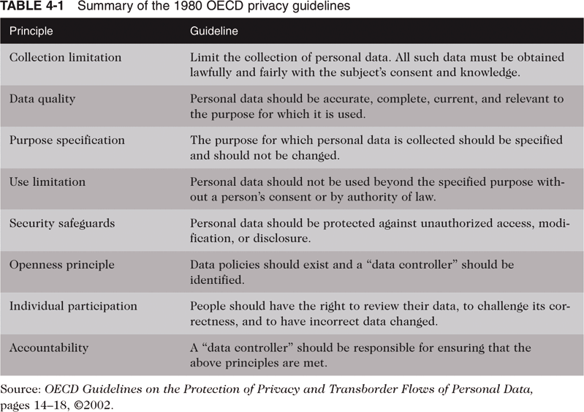
Summary of the 1980 OECD Privacy Guidelines
Ethics in Information Technology, Second Edition
Notes:
Consent - permission for something to happen or agreement to do something
OCED - Organisation for Economic Co-operation and Development

Slide 18
Legal Overview: The Privacy Act
Secure Flight airline safety program
  Compares the names and information of 1.4 million daily U.S. airline passengers with data on known or suspected terrorists
  Violation of Privacy Act
Ethics in Information Technology, Second Edition

Slide 19
Key Privacy and Anonymity Issues
Government electronic surveillance
Data encryption
Identity theft
Customer profiling
Need to treat customer data responsibly
Workplace monitoring
Spamming
Advanced surveillance techniques
Ethics in Information Technology, Second Edition
Notes:
Anonymity - the condition of being anonymous
Surveillance - close observation, especially of a suspected spy or criminal
Spamming - send the same message indiscriminately to (a large numbers of Internet users)

Slide 20
Governmental Electronic Surveillance
Federal Wiretap Act
  Outlines processes to obtain court authorization for surveillance of all kinds of electronic communications
  Judge must issue a court order based on probable cause
    Almost never deny government requests
  “Roving tap” authority
    Does not name specific telephone lines or e-mail accounts
    All accounts are tied to a specific person
Ethics in Information Technology, Second Edition
Notes:
Federal - having or relating to a system of government in which several states form a unity but remain independent in internal affairs
Wiretap - to tap a telephone or telegraph wire in order to get information. transitive verb. : to tap the telephone of

Slide 21
Governmental Electronic Surveillance (continued)
Electronic Communications Privacy Act of 1986 (ECPA)
  Sets standards for access to stored e-mail and other electronic communications and records
  Extends Title III’s prohibitions against the unauthorized interception, disclosure, or use of a person’s oral or electronic communications
  Prosecutor does not have to justify requests
  Judges are required to approve every request
Ethics in Information Technology, Second Edition

Slide 22
Governmental Electronic Surveillance (continued)
Electronic Communications Privacy Act of 1986 (ECPA)
  Highly controversial
    Especially collection of computer data sent over the Internet
  Failed to address emerging technologies
Ethics in Information Technology, Second Edition
Notes:
Emerge - move out of or away from something and become visible

Slide 23
Governmental Electronic Surveillance (continued)
Foreign Intelligence Surveillance Act of 1978 (FISA)
  Allows wiretapping of aliens and citizens in the United States
  Based on finding of probable cause that a target is
    Member of a foreign terrorist group
    Agent of a foreign power
Executive Order 12333
  Legal authority for electronic surveillance outside the United States
Ethics in Information Technology, Second Edition
Notes:
Alien - a foreigner, especially one who is not a naturalized citizen of the country where he or she is living

Slide 24
Governmental Electronic Surveillance (continued)
Communications Assistance for Law Enforcement Act (CALEA)
  Requires the telecommunications industry to build tools into its products so that federal investigators can eavesdrop on conversations
    After getting court approval
  Contains a provision covering radio-based data communication
  Includes voice over Internet (VoIP) technology
Ethics in Information Technology, Second Edition
Notes:
Eavesdrop - secretly listen to a conversation

Slide 25
Governmental Electronic Surveillance (continued)
USA Patriot Act of 2001
  Gives sweeping new powers to
    Domestic law enforcement
    International intelligence agencies
  Contains several “sunset” provisions
Ethics in Information Technology, Second Edition
Notes:
Patriot - a person who vigorously supports their country and is prepared to defend it against enemies or detractors
Sweeping - extending or performed in a long, continuous curve

Slide 26
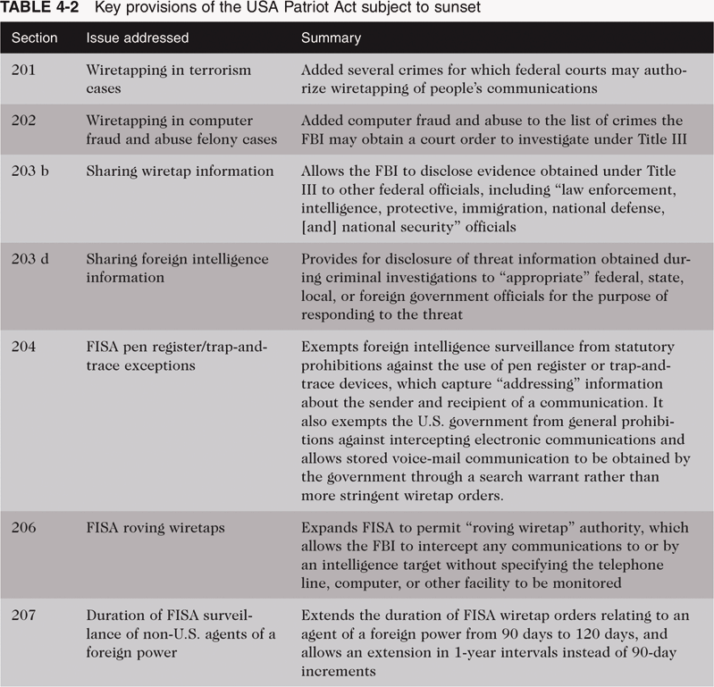
Key Provisions of the USA Patriot Act Subject to Sunset
Ethics in Information Technology, Second Edition

Slide 27
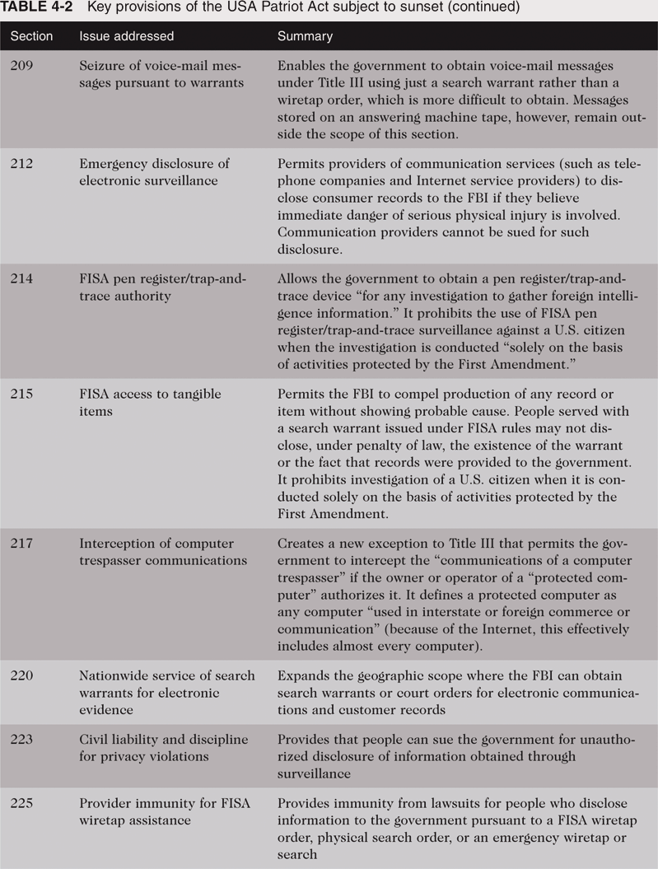
Key Provisions of the USA Patriot Act Subject to Sunset (continued)
Ethics in Information Technology, Second Edition

Slide 28
Data Encryption
Cryptography
  Science of encoding messages
  Only sender and intended receiver can understand the messages
  Key tool for ensuring confidentiality, integrity, authenticity of electronic messages and online business transactions
Encryption
  Process of converting electronic messages into a form understood only by the intended recipients
Ethics in Information Technology, Second Edition

Slide 29
Data Encryption (continued)
Encryption key
  Variable value applied using an algorithm to encrypt or decrypt text
Public key encryption system uses two keys
  Message receiver’s public key - readily available
  Message receiver’s private key - kept secret
RSA - a public key encryption algorithm
Private key encryption system
  Single key to encode and decode messages
Ethics in Information Technology, Second Edition

Slide 30
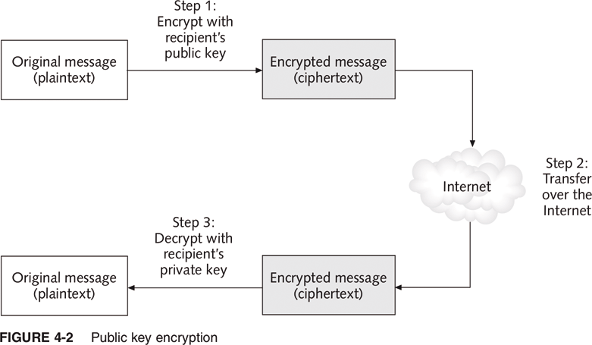
Public Key Encryption
Ethics in Information Technology, Second Edition

Slide 31
Data Encryption (continued)
Most people agree encryption eventually must be built into
  Networks
  File servers
  Tape backup systems
Seagate Technology hard drive
  Automatically encrypts all data
U.S. Arms Export Control Act controls the export of encryption technology, hardware, and software
Ethics in Information Technology, Second Edition

Slide 32
Identity Theft
Theft of key pieces of personal information to gain access to a person’s financial accounts
Information includes:
  Name
  Address
  Date of birth
  Social Security number
  Passport number
  Driver’s license number
  Mother’s maiden name
Ethics in Information Technology, Second Edition

Slide 33
Identity Theft (continued)
Fastest growing form of fraud in the United States
Lack of initiative in informing people whose data was stolen
Phishing
  Attempt to steal personal identity data
  By tricking users into entering information on a counterfeit Web site
  Spear-phishing - a variation in which employees are sent phony e-mails that look like they came from high-level executives within their organization
Ethics in Information Technology, Second Edition

Slide 34
Identity Theft (continued)
Spyware
  Keystroke-logging software
  Enables the capture of:
    Account usernames
    Passwords
    Credit card numbers
    Other sensitive information
  Operates even if an infected computer is not connected to the Internet
Identity Theft and Assumption Deterrence Act of 1998 was passed to fight fraud
Ethics in Information Technology, Second Edition

Slide 35
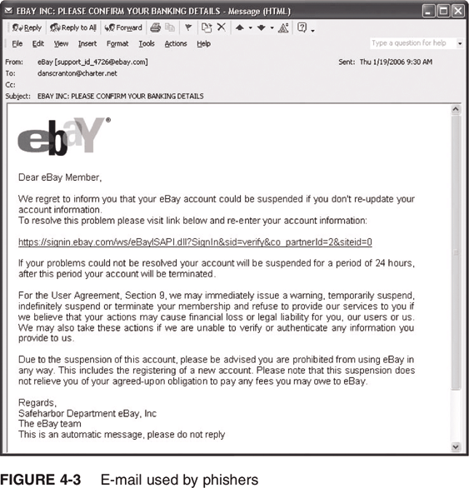
E-mail Used by Phishers
Ethics in Information Technology, Second Edition

Slide 36
Consumer Profiling
Companies openly collect personal information about Internet users
Cookies
  Text files that a Web site puts on a user’s hard drive so that it can remember the information later
Tracking software
Similar methods are used outside the Web environment
Databases contain a huge amount of consumer behavioral data
Ethics in Information Technology, Second Edition

Slide 37
Consumer Profiling (continued)
Affiliated Web sites
  Group of Web sites served by a single advertising network
Customized service for each consumer
Types of data collected while surfing the Web
  GET data
  POST data
  Click-stream data
Ethics in Information Technology, Second Edition

Slide 38
Consumer Profiling (continued)
Four ways to limit or even stop the deposit of cookies on hard drives
  Set the browser to limit or stop cookies
  Manually delete them from the hard drive
  Download and install a cookie-management program
  Use anonymous browsing programs that don’t accept cookies
Ethics in Information Technology, Second Edition

Slide 39
Consumer Profiling (continued)
Personalization software is used by marketers to optimize the number, frequency, and mixture of their ad placements
  Rules-based
  Collaborative filtering
  Demographic filtering
  Contextual commerce
Platform for Privacy Preferences (P3P)
  Shields users from sites that don’t provide the level of privacy protection desired
Ethics in Information Technology, Second Edition

Slide 40
Treating Consumer Data Responsibly
Strong measures are required to avoid customer relationship problems
Code of Fair Information Practices
1980 OECD privacy guidelines
Chief privacy officer (CPO)
  Executive to oversee data privacy policies and initiatives
Ethics in Information Technology, Second Edition

Slide 41
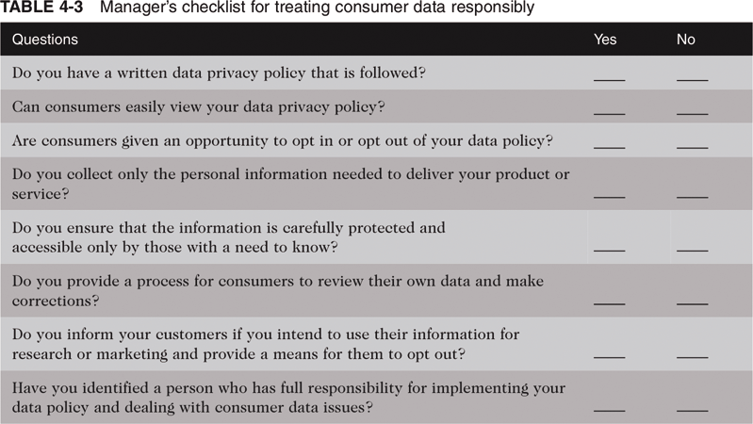
Manager’s Checklist for Treating Consumer Data Responsibly
Ethics in Information Technology, Second Edition

Slide 42
Workplace Monitoring
Employers monitor workers
  Ensures that corporate IT usage policy is followed
Fourth Amendment cannot be used to limit how a private employer treats its employees
  Public-sector employees have far greater privacy rights than in the private industry
Privacy advocates want federal legislation
  To keeps employers from infringing upon privacy rights of employees
Ethics in Information Technology, Second Edition

Slide 43
Spamming
Transmission of the same e-mail message to a large number of people
Extremely inexpensive method of marketing
Used by many legitimate organizations
Can contain unwanted and objectionable materials
Ethics in Information Technology, Second Edition
Notes:
Legitimate - conforming to the law or to rules

Slide 44
Spamming (continued)
Controlling the Assault of Non-Solicited Pornography and Marketing (CANSPAM)
  Says it is legal to spam but
    Spammers cannot disguise their identity
    There must be a label in the message specifying that the e-mail is an ad or solicitation
    They must include a way for recipients to indicate they do not want future mass mailings
Ethics in Information Technology, Second Edition

Slide 45
Advanced Surveillance Technology
Camera surveillance
  U.S. cities plan to expand surveillance systems
  “Smart surveillance system”
Facial recognition software
  Identifies criminal suspects and other undesirable characters
  Yields mixed results
Global Positioning System (GPS) chips
  Placed in many devices
  Precisely locate users
Ethics in Information Technology, Second Edition

Slide 46
Summary
The legal concept of the right to privacy has four aspects
A number of laws have been enacted over the past 40 years that affect a person’s privacy
Laws authorize electronic surveillance by the government
Data encryption
  Public key encryption system
  Private key encryption system
Identity theft
Ethics in Information Technology, Second Edition

Slide 47
Summary (continued)
Consumer behavior data is collected both online and offline
Code of Fair Information Practices and 1980 OECD privacy guidelines
Employers record and review employee communications and activities on the job
Advances in information technology
  Surveillance cameras
  Facial recognition software
  GPS systems
Ethics in Information Technology, Second Edition

